Slide 1


A comparison of Chicago neighborhoods in terms of business and social activity against crime rate.
Data Science – Final Capstone Project by Marc Hauptmann

Slide 2
Introduction / Business Problem
Crime rates in Chicago higher than US average, especially for violent crimes [Ref1]
2 related questions to be investigated in this study:
Is there a relationship between types of business venue activity in Chicago neighborhoods and the frequency and type of crimes committed?
How do neighborhoods in Chicago compare in terms of ‘prosperity’ and ‘safety’ (i.o.w. what are safe, flourishing neighborhoods in Chicago and what distinguishes them from ‘languishing’, ‘crime ridden’ ones)?
Affected stakeholders:
Law enforcement → where to deploy police force?
Social and business developers → In which neighborhoods to plan and budget which projects?
Business owners and investors → Where to settle which type of businesses?
[Ref1]: http://www.city-data.com/crime/crime-Chicago-Illinois.html, accessed 13-dec 2020.

Slide 3
Data requirements and sources
Business venue activity per neighborhood in Chicago , constructed out of:
An overview of Chicago Neighborhoods incl. geospatial definitions of the neighborhood boundaries. [Ref2]
Data on venues incl. types of venues, longitude and latitude, retrieved based on neighborhood location and size. [Ref3]
Annual overview of crimes committed in the Chicago area incl. the locations of the crimes committed. [Ref4]
[Ref2]: Neighborhood boundaries in Chicago, developed by the Office of Tourism: https://data.cityofchicago.org/Facilities-Geographic-Boundaries/Boundaries-Neighborhoods/bbvz-uum9 , accessed 13-dec 2020.
[Ref3]: Foursquare website: https://foursquare.com/ , accessed 13-dec 2020.
[Ref4]: https://www.chicago.gov/city/en/dataset/crime.html , accessed 13-dec 2020.

Slide 4
Methodology
4 main steps:
Setting up and visualizing the geographical information of the Chicago neighborhoods.
Extracting the relevant crime statistics data, as well as linking to and aggregating with respect to the Chicago Neighborhood geographical information.
Retrieving and analyzing the relevant venue information based on the geographical charac-teristics of the Chicago neighborhoods.
Comparing and analyzing the communalities and differences between the crime and venue characteristics of the Chicago neighborhoods as extracted in steps 2 and 3, respectively.

Slide 5
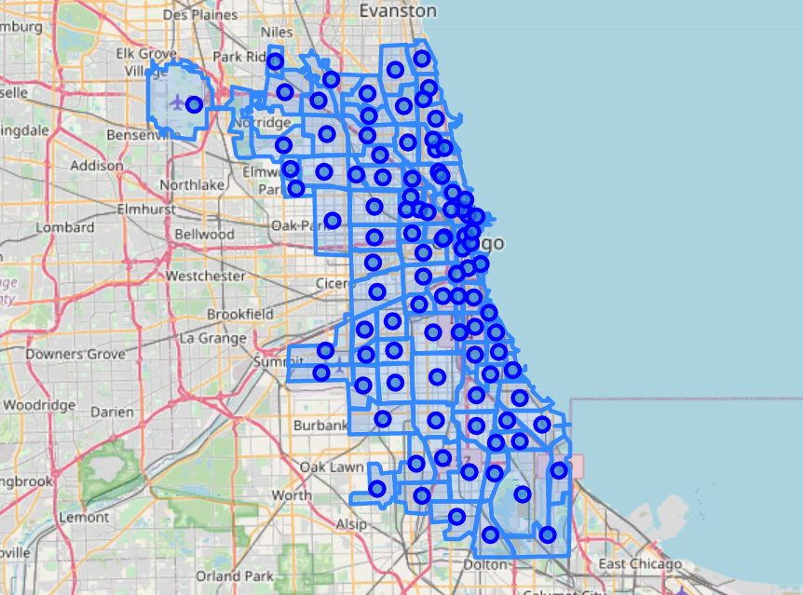
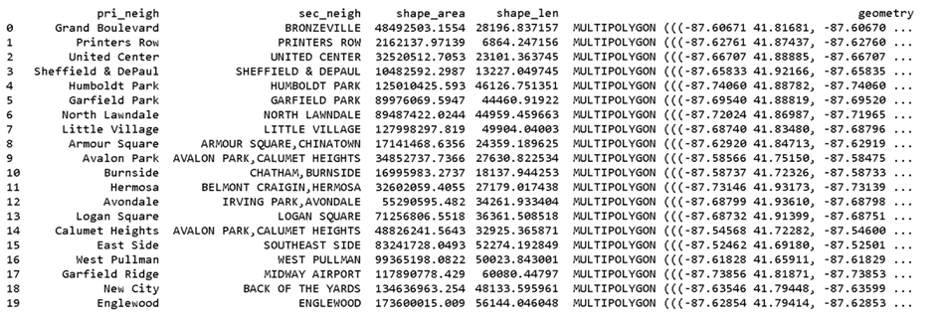
Methodology con’t
Setting up and visualizing the geographical information of the Chicago neighborhoods
1. Visualize Neighborhood boundaries in Folium.
GeoJSON file retrieved via [Ref2]
2. Determine centroids with geopandas and visualize as markers in Folium

Slide 6
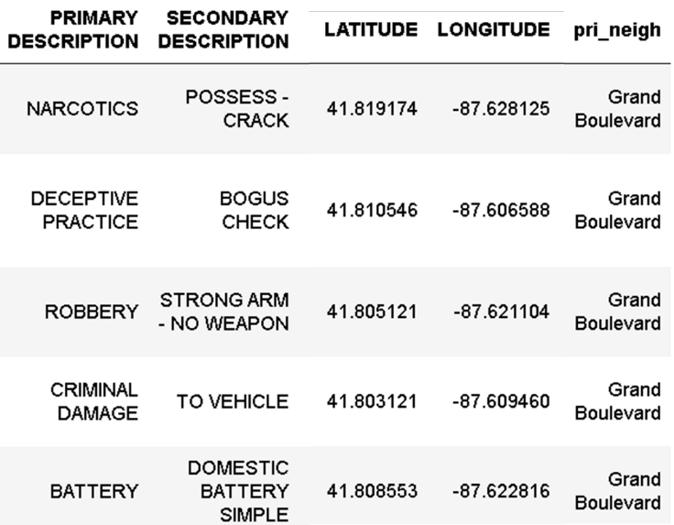
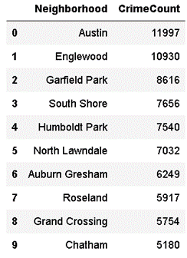
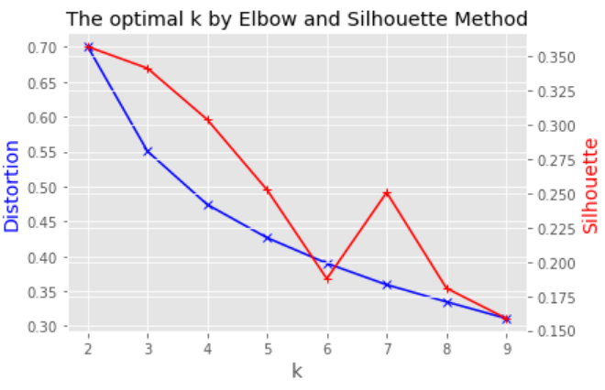
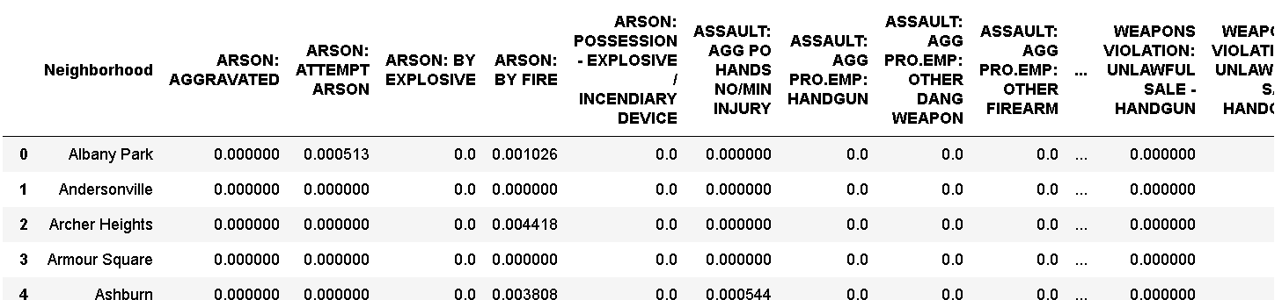
Methodology con’t
Extracting the relevant crime statistics data, as well as linking to and aggregating with respect to the Chicago Neighborhood geographical information.
Dataframe with description of crime and mapped neighborhood
Crime rate per neighborhood
Crime data from [Ref4]
1. Map to neighborhoods using geopandas
2. Aggregate
4. kMeans clustering with “optimal” number of groups k
3. Determine frequency per crime type per neighborhood
k=3

Slide 7
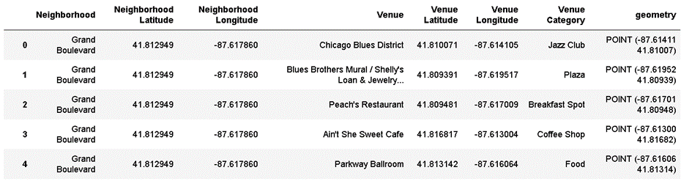
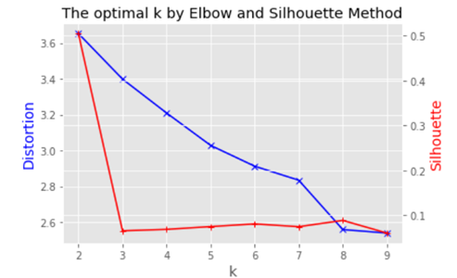
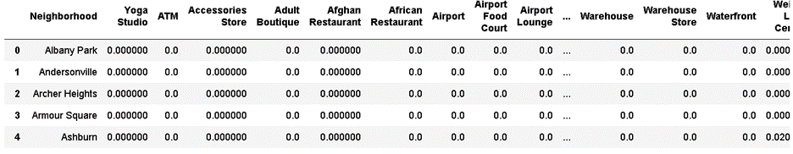
Methodology con’t
Retrieving and analyzing the relevant venue information based on the geographical characteristics of the Chicago neighborhoods.
Venue information extracted from [Ref3] and mapped to each neighborhood
Use same k as for crime-based clustering for bettercomparison
1. Determine frequency per venue type per neighborhood
k=3
2. kMeans clustering with “optimal” number of groups k

Slide 8
Methodology con’t
Comparing and analyzing the communalities and differences between the crime and venue characteristics of the Chicago neighborhoods.
Global KPIs for clustering comparison:
Adjusted Rand Index [Ref5]
Jaccard similarity score [Ref6]:
Requires remapping of clusters
Weighted average of per cluster score
Total score based on total number of true and false positives and negatives
Confusion matrix [Ref7]:
Venue-based clusters
 | Cluster 0 | Cluster 1 | Cluster 2 | Total
Cluster 0 | #Mat-ches | #Mat-ches | #Mat-ches | RowSum
Cluster 1 | #Mat-ches | #Mat-ches | #Mat-ches | RowSum
Cluster 2 | #Mat-ches | #Mat-ches | #Mat-ches | RowSum
Total | ColSum | ColSum | ColSum
Crime-based clusters
[Ref5]: "Objective criteria for the evaluation of clustering methods" by William M. Rand, Journal of the American Statistical Association 66 (336): 846–850 (1971).
[Ref6]: https://scikit-learn.org/stable/modules/generated/sklearn.metrics.jaccard_score.html , accessed 3-jan 2021.
[Ref7]: “Selecting and interpreting measures of thematic classification accuracy" by Stephen V. Stehman, Remote Sensing of Environment. 62 (1): 77–89 (1997).

Slide 9
Results
Crime characteristics of Chicago neighborhoods
Characteristic venues of Chicago neighborhoods
Relationship between crime and venue characteristics of Chicago neighborhoods

Slide 10
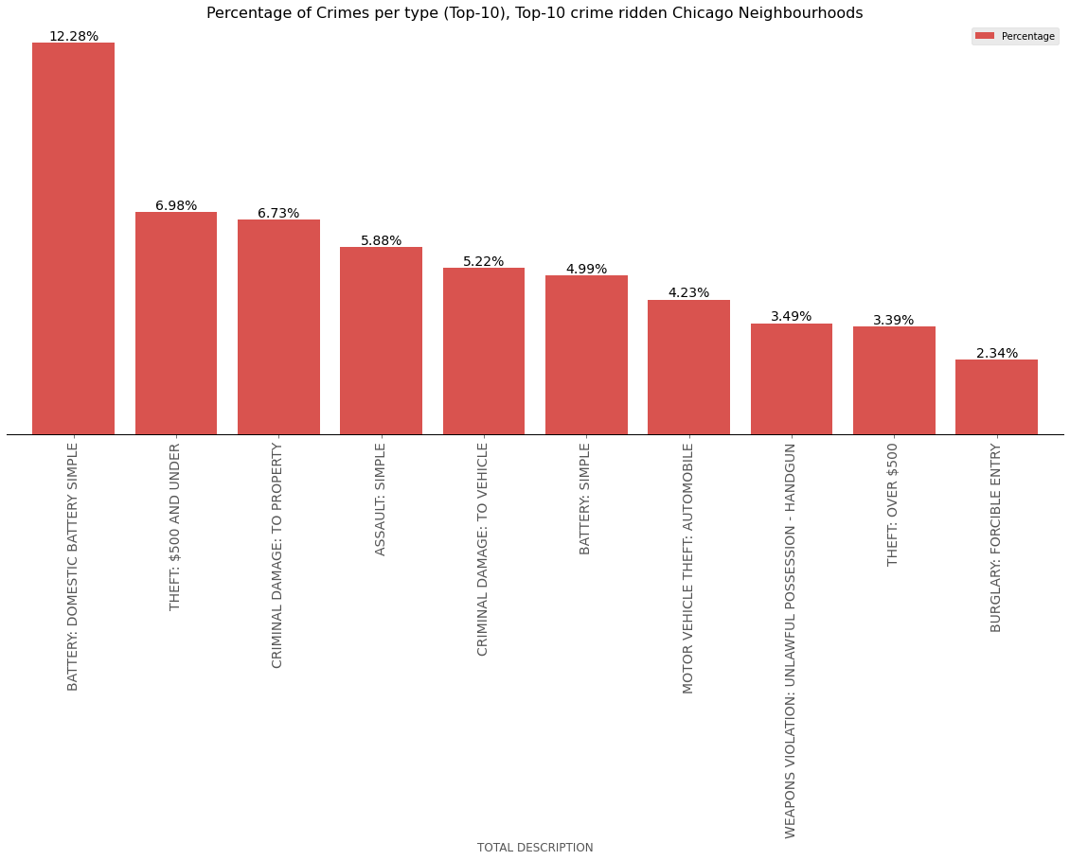
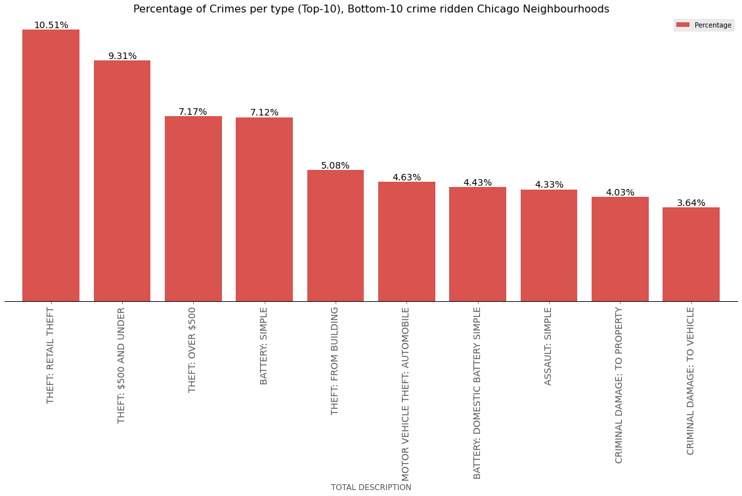
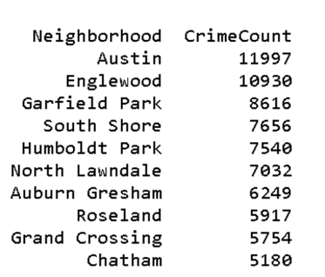
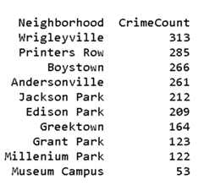
Results con’t
Crime characteristics of Chicago neighborhoods
Top crime-ridden neighborhoods characterized by violent crimes
Least crime-ridden neighborhoods characterized by various types of theft

Slide 11
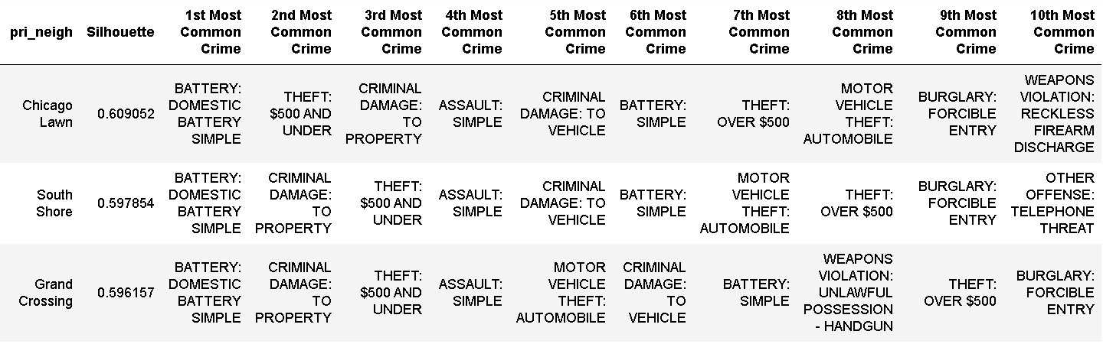
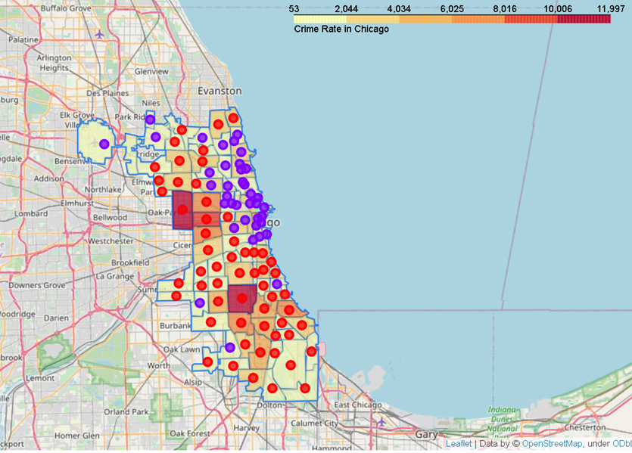
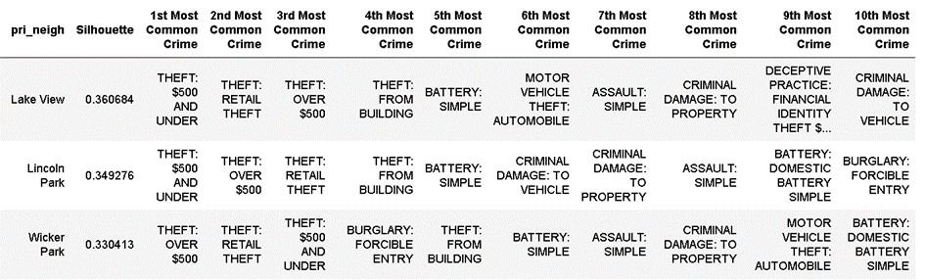
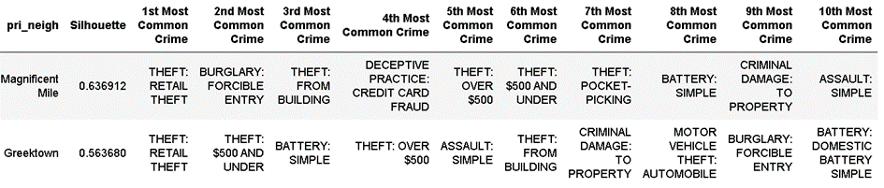
Results con’t
Crime characteristics of Chicago neighborhoods
Geographic distribution of different types of crimes and link to crime rate
Violent crimes
Petty and heavier theft
Retail theft

Slide 12
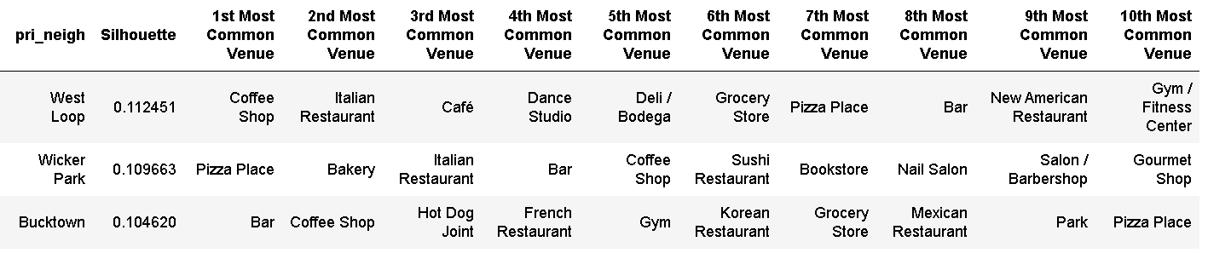
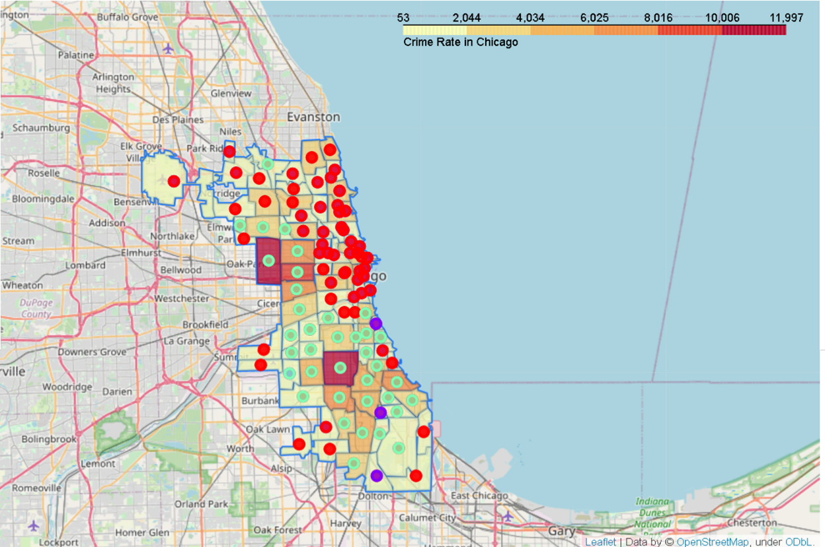
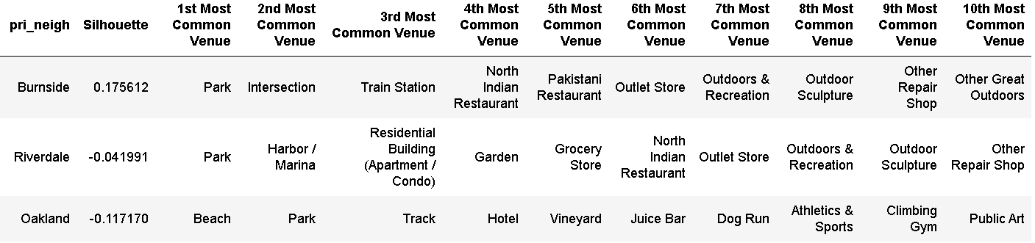
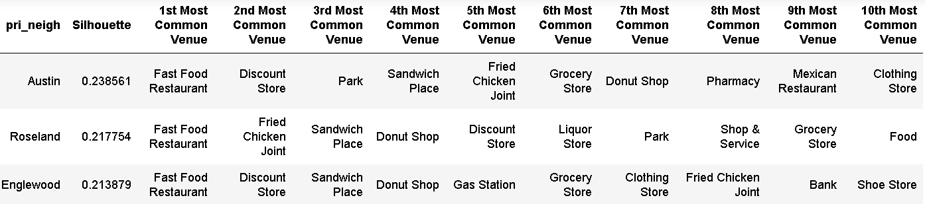
Results con’t
Characteristic venues of Chicago neighborhoods
Geographic distribution of different types of venues and link to crime rate
Bars, Restaurants,
Outdoor
Fast food, Discount stores

Slide 13
Results con’t
Relationship between crime and venue characteristics of Chicago neighborhoods.
Geographic distribution of different types of crimes and link to crime rate
Geographic distribution of different types of venues and link to crime rate
Main clusters match geographically

Slide 14
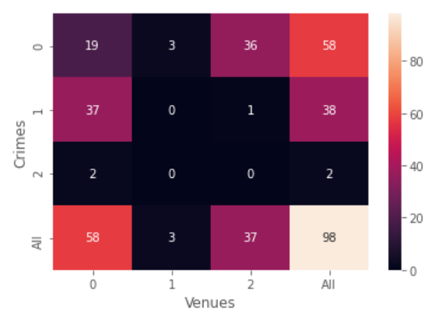
Results con’t
Relationship between crime and venue characteristics of Chicago neighborhoods.
Global KPIs for clustering comparison:
Adjusted Rand Index: 0.27
Affected by cluster size
Jaccard similarity score:
Weighted average of per cluster score 0.60
Total score based on total number of true and false positives and negatives 0.59
Confusion matrix:
Main clusters match in terms of neighborhoods assigned

Slide 15
Discussion
Prosperous neighborhoods (North-East of Chicago) exhibit vast amount of high-profile business venues
Crime rate generally lower in these neighborhoods, with the committed crimes being less severe.
Less prosperous neighborhoods ([South]-East of Chicago) dominated by less glamorous venues.
Crime rate is the highest in Chicago, with the majority of crimes of more violent nature.

Slide 16
Discussion con’t
The likely underlying rootcause can be found in the socio-demographic characteristics of these neighborhoods:
The majority of the population in the crime-ridden neighborhoods lives in precarious circumstances.
less attractive for more high-profile business ventures due to a lack of matching “clientele”. [Ref8-10]
lack of employment and perspective may cause high amount of (domestic) violence.
More prosperous neighborhoods are either mainly offering high profile housing like lofts [Ref11] or are in-fact non-residential business and/or entertainment areas [Ref12-14].
These may in general attract more wealthy “clientele”
[Ref8]: https://en.wikipedia.org/wiki/Austin,_Chicago , accessed 3-jan 2021.
[Ref9]: https://en.wikipedia.org/wiki/Englewood,_Chicago , accessed 3-jan 2021.
[Ref10]: https://en.wikipedia.org/wiki/West_Garfield_Park,_Chicago & https://en.wikipedia.org/wiki/East_Garfield_Park,_Chicago , accessed 3-jan 2021.
[Ref11]: https://en.wikipedia.org/wiki/Printer%27s_Row,_Chicago , accessed 3-jan 2021.
[Ref12]: https://en.wikipedia.org/wiki/Millennium_Park , accessed 3-jan 2021.
[Ref13]: https://en.wikipedia.org/wiki/Museum_Campus , accessed 3-jan 2021.
[Ref14]: https://en.wikipedia.org/wiki/Magnificent_Mile , accessed 3-jan 2021.

Slide 17
Discussion con’t
In general little diversity in terms of venues ➔ Recommendation to develop neighborhoods appropriately in order to attract appropriate businesses, increase quality of living, while avoiding repelling current population.

Slide 18
Conclusion and outlook
Characteristics that separate poor, crime-ridden neighborhoods from flourishing, ‘safe’ neighborhoods identified.
Some general suggestions provided on how (not) to try to improve the situation in the poorer, more crime-ridden areas in a sustainable, long-term way.
Future investigations to yield more in-depth insights and specific recommendations should include more data sources and aspects:
E.g.: population demographics, educational situation, other types of business activity (e.g. industrial activity), etc.
Use more elaborate machine learning techniques to maximize feature co-variance such as PCA. [Ref15]
[Ref15]: “Analysis of a complex of statistical variables into principal components” by Harold Hotelling, Journal of Educational Psychology, 24, 417–441, and 498–520, (1933).

